Slide 1
Anti-LGBTQ Hate Crimes Presentation
Illinois House of Representatives
Presented by:
Aster Gilbert (she/they)
Manager of Training & Public Education
agilbert@centeronhalsted.org

Slide 2
National Trends: Anti-LGBTQ Hate Crimes
Hate Crime laws recognize LGBTQ people in two categories:
Gender identity
Sexual orientation
Notes:
Victims of Hate Crime Incidents
8,052 single-bias incidents involved 11,126 victims
In 211 incidents, a total of 346 victims were targeted because of more than one bias
2020 – increase from 2019
LGBTQIA+ includes identities based on (Anti-Violence Project)
Sex (anatomy)
Gender
Sexual Orientation
HIV status

Slide 3
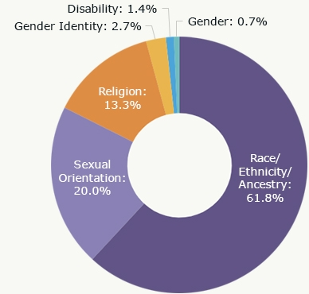
National Trends: Anti-LGBTQ Hate Crimes
Increase in anti-LGBTQ hate crimes since 2015 (NCAVP)
2019 saw major spike (NCAVP)
DOJ & FBI data from 2020 shows increase from 2019
HRC reported an “epidemic of violence” in 2021
Sexual Orientation is consistently the second most-targeted group
Rates vary based on race, ethnicity, national origin, socio-economic class
Black LGBTQ people 91% of homicide victims in 2019
source: DOJ + FBI 2020 Hate Crimes Data
Notes:
Victims of Hate Crime Incidents
8,052 single-bias incidents involved 11,126 victims
In 211 incidents, a total of 346 victims were targeted because of more than one bias
2020 – increase from 2019

Slide 4
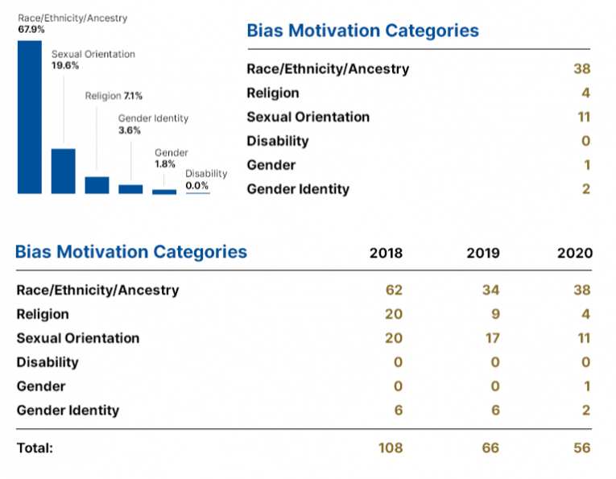
Illinois Trends: Anti-LGBTQ Hate Crimes
Southern Poverty Law Center tracks 23 hate groups in IL
4 explicitly anti-LGBTQ
7 white nationalist, neo-Nazi, neo-Völkisch
3 “general hate” (Proud Boys)
Youth Experience of Hate (Healthy CPS, CDC, APA data)
LGBTQIA students face higher rates of
physical & digital bullying
lowest rates of feeling safe
higher rates of punishment
Leads to higher rates of:
truancy
homelessness
drug use
bringing weapons to school
source: DOJ + FBI 2020 Hate Crimes Data
Notes:
NOTE: numbers do not tell the whole story – UNDEREPORTING – discretion of police officers, victim/survivor not wanting to report (or knowing to report)
LGBTQ populations tend to be larger (almost double) the visible/out number

Slide 5
What is Causing the Rise?
2022 – spread of “Grooming” campaigns: stoking moral panic by calling all LGBTQ people sexual predators
262 anti-LGBTQ bills introduced nationwide in 2022
Rise in far-right extremist groups
Rise in online radicalization of children, youth, and young adults
Economic Precarity + Crisis of Legitimacy + Perceptions of Loss → fuel radicalization
Notes:
Anti-LGBTQ political platforms
Culture Wars
Major funding of politicians running on anti-LGBTQ platforms (Alliance Defending Freedom, etc.)

Slide 6
Solutions & Suggested Areas of Focus
Holistic approaches that tackles economic inequality and racial disparities
Funding preventative solutions
police limited to responding after hate incident occurs
funding for community organizations, service providers, education networks
Research and Aggregated Data
Protecting and funding the institutions targeted: public schools, comprehensive sex education, libraries
3. Cross-state/Federal solutions (networks of anti-LGBTQ groups and funders)

Slide 7
Thank you! Questions? Comments?
agilbert@centeronhalsted.org
Anti-violence project 773-871-2273 AVP@CENTERONHALSTED.ORG

